Slide 1
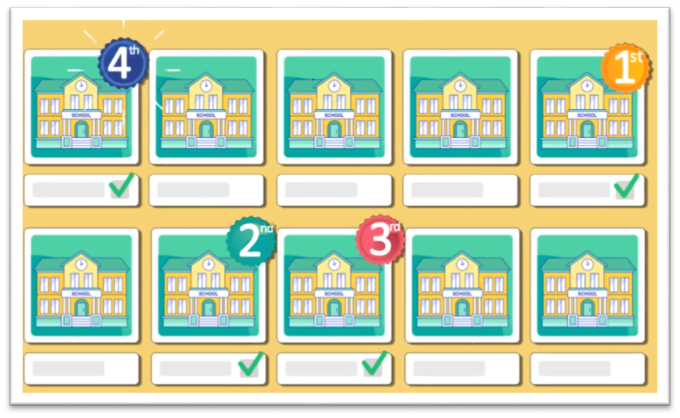
Guidance on accessing your child’s placement notification via the Citizen Portal
Pre-School and Primary Admissions 2020/2021

Slide 2
Getting started
If you had applied online in January 2020 for a pre-school or primary 1 place you can access your child’s pre-school/school placement on the Citizen Portal from 12 noon on Wednesday 29 April 2020.
www.eani.org.uk/admissions Citizen Portal
The following steps will guide you on how to access your child’s information on the portal

Slide 3
Log in to the Portal using your registered email address and password
If you are unable to log in successfully, please make sure you have correctly entered your email address and password (and remember that your password had at least 2 numbers and a special character). You can reset your password by clicking the ‘Forgotten your password’ link.

Slide 4
Click on the tile ‘View Offer for Pre-School/ School’

Slide 5
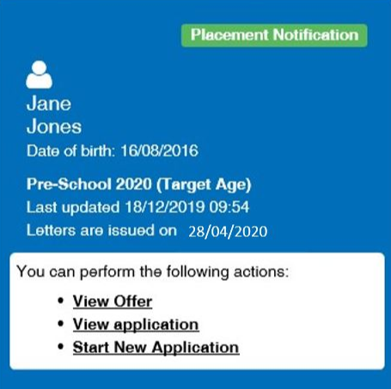
To view your child’s placement notification (after 12 noon on 29 April)
Look for the Pre-School 2020 (Target Age), Primary 2020 or Reception 2020 tile as appropriate
Click View Offer

Slide 6
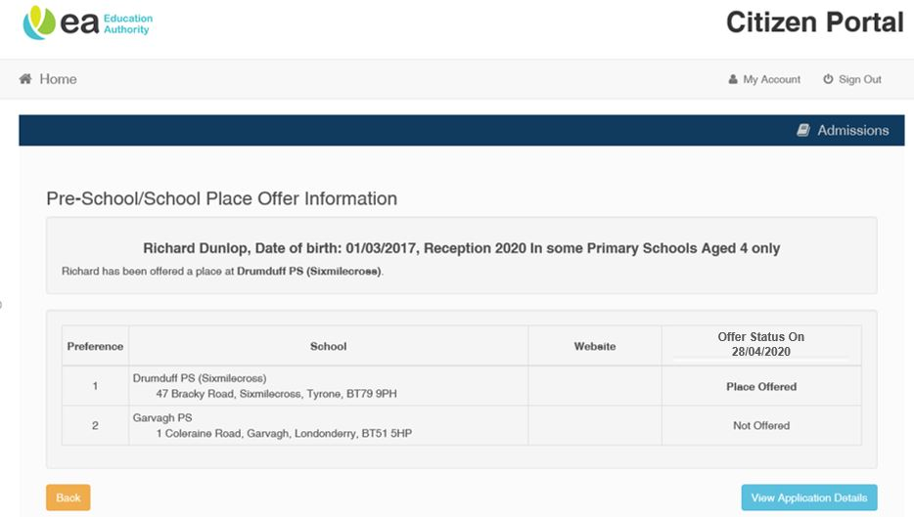
Offer status indicates the Pre-School/ School where a place is being offered
Any abbreviations in the pre-school/school name mean:-
PS = Primary School
PS NU = Primary School Nursery Unit
NS = Nursery School
PG = Playgroup
FT = Full-time
PT = Part-time
In some pre-schools/schools this offer of a place may be conditional on you providing verifying documents. If that is the case the pre-school/school will write to you separately, when it is able to do so, indicating what documents it needs.

Slide 7
A small number of children have not been offered a place in any of the pre-schools/ schools listed on their application. If this is the case the offer status will show as ‘Not offered’ for all the preferences listed. Letters issued by the Education Authority provide guidance for parents/guardians on how to submit further preferences for consideration by pre-schools/schools. You can also find information on how to appeal the decision of a nursery school/unit or primary school not to admit your child on the Education Authority’s website www.eani.org.uk/admissions. There is no right of appeal against a playgroup. Please note that consideration of further applications by pre-schools/schools and admissions appeals for schools will be arranged as soon as is practicably possible.
What does ‘No current offer’ mean?

Slide 8
Sources of Help
To access the Citizen Portal use the link below
www.eani.org.uk/admissions
You can find further information and support on the website or via the
EA’s Admissions Helpdesk:  028 9598 5595
: preschooladmissions@eani.org.uk or primaryadmissions@eani.org.uk
Due to restrictions resulting from Covid-19 it may take longer than normal for queries to be addressed.
We appreciate your patience while we try to help you.
If you need further information about a decision that has been made you can contact the
pre-school(s)/school(s) to which you had applied, by email.
Contact details are available from https://www.eani.org.uk/search-schools

